Slide 1
Benefits Claims Decision Support System Date: 12/11/15 PM: Elizabeth Wollin
Schedule | Staffing | Funding | Integration | Stakeholder Comms | VBA Overall | OI&T Overall
● | ● | ● | N/A | ● | ● | ●
Cross Dependencies: N/A
Completed this Week:
Developed BCDS Summary Use Case briefing
Created User Story Backlog
Reviewed/Revision of User Stories
Participated in User Story Elaboration with VA PM
Developed SDD Section 3 initial integration patterns/system architectural diagrams
Conducted Infrastructure Architecture Diagrams Review Meeting
Participated in meeting with Perceptive Reach team (P. Bradley) to discussion "portable" repots, products and specifications
Participated in meetings with VBA PA&I staff on exam data and usefulness to modeling efforts
Installed Oracle within newly provisioned data server in FTL to provide a data-store emulating the system of record for veteran data feeding the to-be predictive model engine
Request provisioning of new servers which will serve as an Dev Integration server and a UAT/Demo server
Overdue:
None
Due Next Week:
Initial meeting with SMEs on Summary Use Case/User Stories
Initial review of data to evaluate prep needs prior to development of "proxy" model
Meetings on System design and form of model storage/application
Working session with DENTT to gather appropriate DVS sheets for processing
Assuming data arrives, configuration of Oracle to accept received data file
Working sessions to validate proposed high-level architecture for SDD
Continue User Story Elaboration with VA PM and SMEs
Continue populating SDD Section 3
Acquisition Package and CR Updates:
N/A

Slide 2
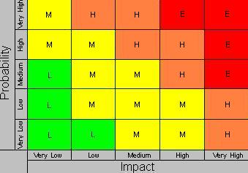
Benefits Claims Decision Support System Date: 12/11/15 PM: Elizabeth Wollin
Risk 1:
Title: Schedule [12/11/15]
Risk: If delays in obtaining data.
Impact: The deliverables will be delayed.
Mitigation Steps to Date:
Regularly communicate timeline and data needs with VA PM.
Action Items:
VA PM working to obtain required agreements for data and data transfer.
Who: VA PM Due Date: Ongoing
Risk 2:
Title: Technical [12/11/15]
Risk: If expectations re: Mitre Scripts and Analysis duplication.
Impact: VA Stakeholder buy-in may not be obtained.
Mitigation Steps to Date:
Clearly Communication project approach and potential benefits with Business and Technical subject matter experts (SMEs).
Action Items:
Coordinates project meetings with Business and Technical SMEs.
Who: VA PM and Project Team Due Date: Ongoing
1
2

